Slide 1

Topic Modeling of depression drug reviews
By Yordanos Wodebirhan
July 2021
Metis bootcamp

Slide 2
Questions
What are common side effects of depression medication?
Issues that concern patients on depression medication ?
Which depression drugs have the most side effects ?

Slide 3
Data
Source
Data_set
Attributes
UCI ML repository
12,164 7,112
Reviews, rating, drug names

Slide 4
Methodology
Lowercase; remove punctuations, numbers, stop words; lemmatization
1. Data preprocessing
2. Vectorization
Tfidf
NMF , 20 topics
3. Topic Modeling
Top review &Top word expressions
4. Topic Interpretation

Slide 5
Topics
Length of time on medications
Weight Gain caused by medication
Dose of medication
Anxity
Nausea
Panic Attack
Changes and improvements
Sleep problems
Sex drive

Slide 6
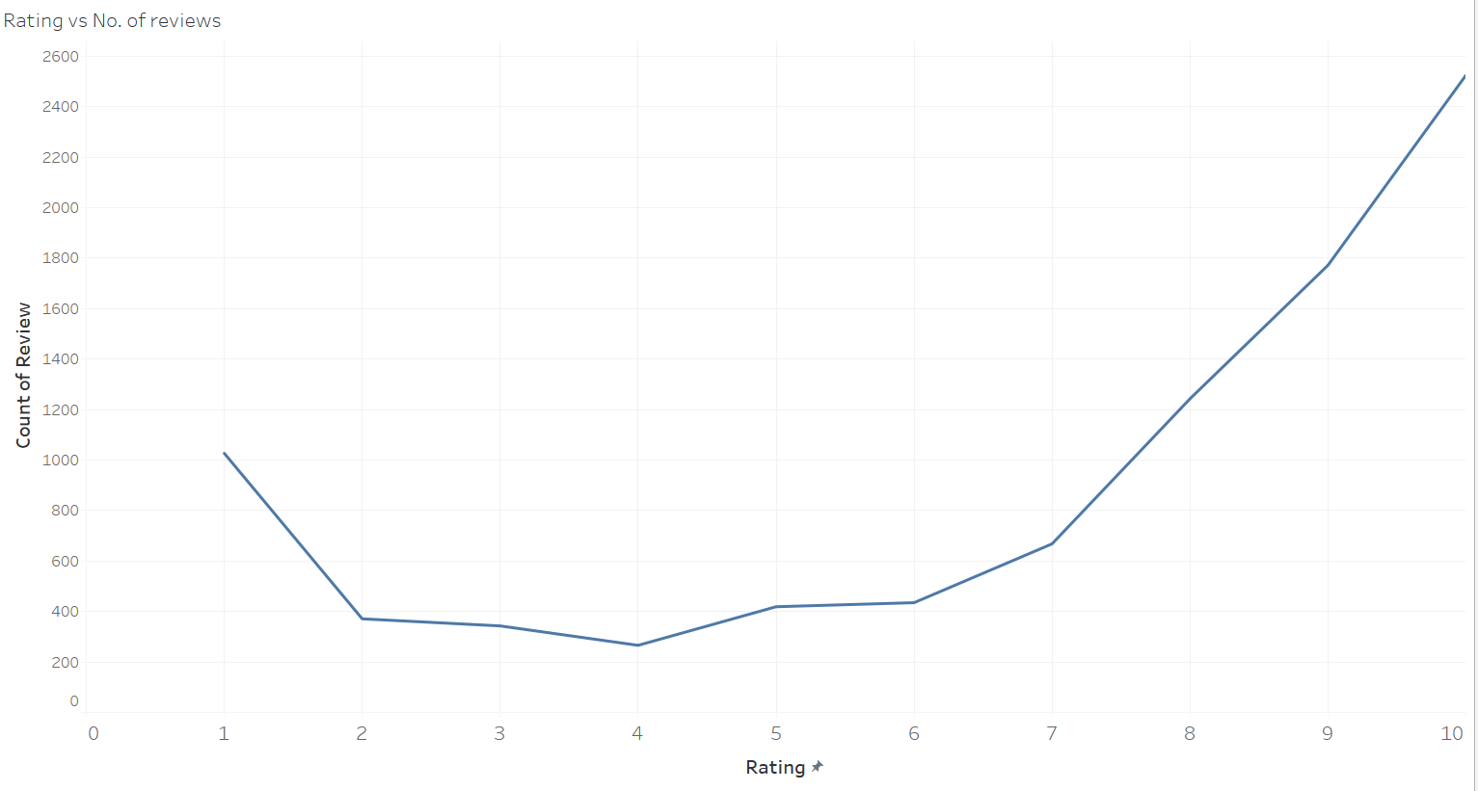
Topics / Ratings

Slide 7
Topics / Ratings
Positive Rating > 5
Avg. Negative Rating
Avg. Positive Rating
2.4
8.8

Slide 8
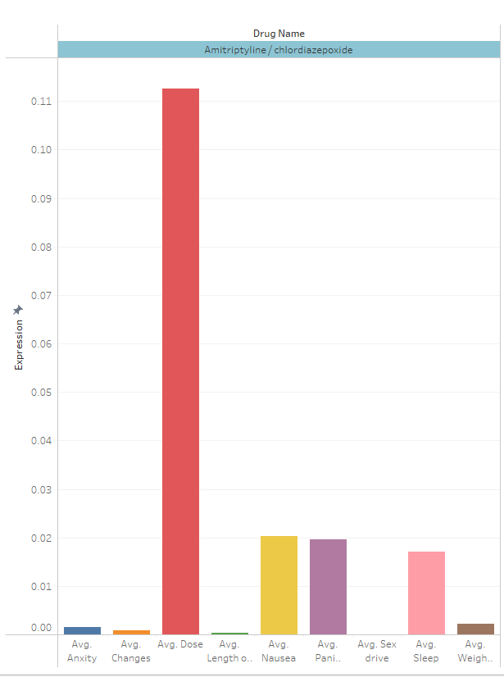
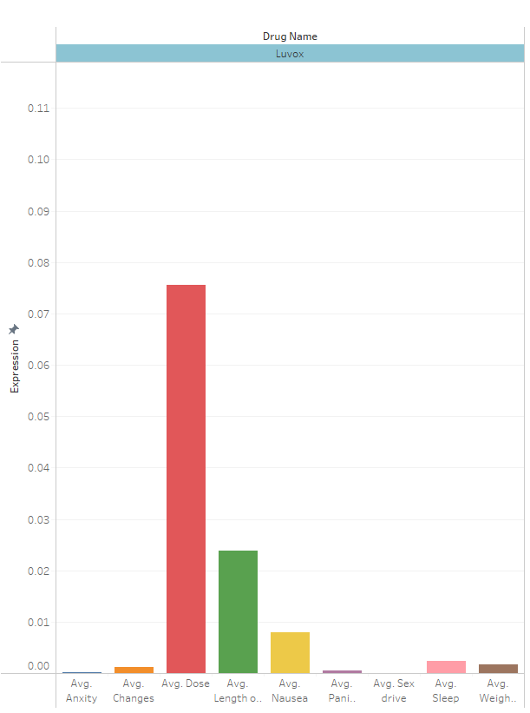
Topics / Drugname – Dose of medication
115 depression drugs were reviewed

Slide 9
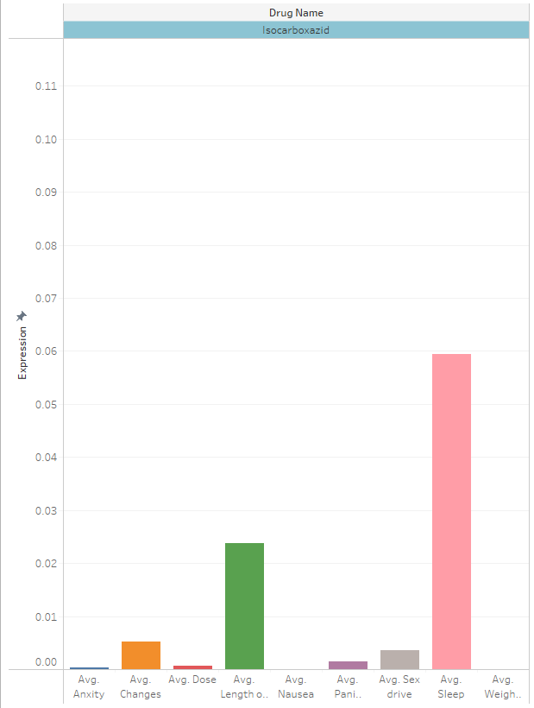
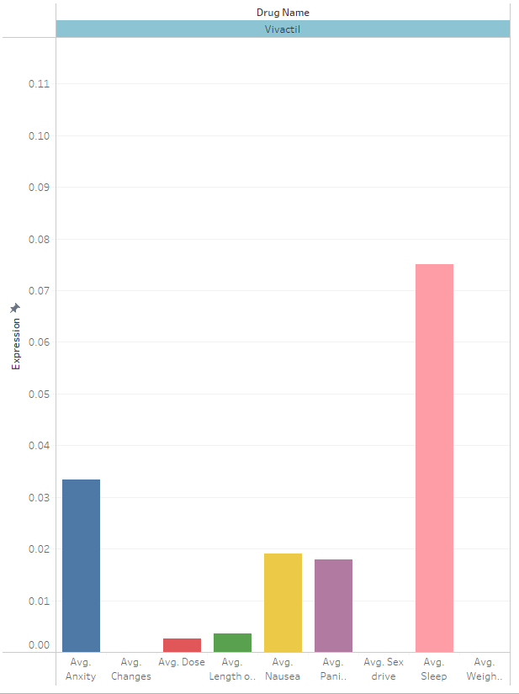
Topics / Drugname - Sleep

Slide 10
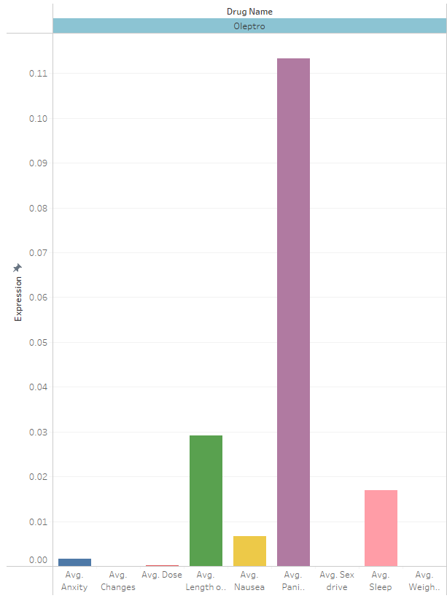
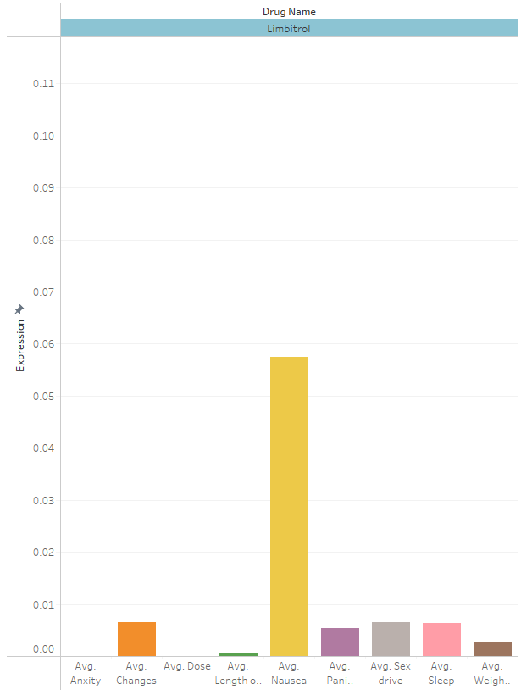
Topics / Drugname – Panic attack , Nausea
Oleptro avg rating = 1

Slide 11
Conclusion
most common side effects : anxiety, weight gain, nausea
This drugs mostly work well
Drugs such as Oleptro is less preferred

Slide 12
Thank You

